Slide 1
REQUIREMENTS DOCUMENT FOR THE COMPLEX INFORMATION SYSTEM DEVELOPMENT PROJECT
CMPG 213 - Phase 2
Group 10

Slide 2
Table Of content
1. Project Plan
2. Definitions, acronyms and abbreviations
3. Project description and Scope
4. Functional requirements i.e.
a) business data requirements (inputs, outputs),
b) business processes requirements and
c) business interface requirements
5. Non-functional requirements (categorized according to the PIECES Framework)
6. Candidate Systems Matrix
7. Feasibility Analysis Matrix
8. Use-Case Glossary & Use-Case Model Diagram
9. Examples of data, questionnaires, fact-finding techniques used
10. Summary, future & further planning (PERT Chart)

Slide 3
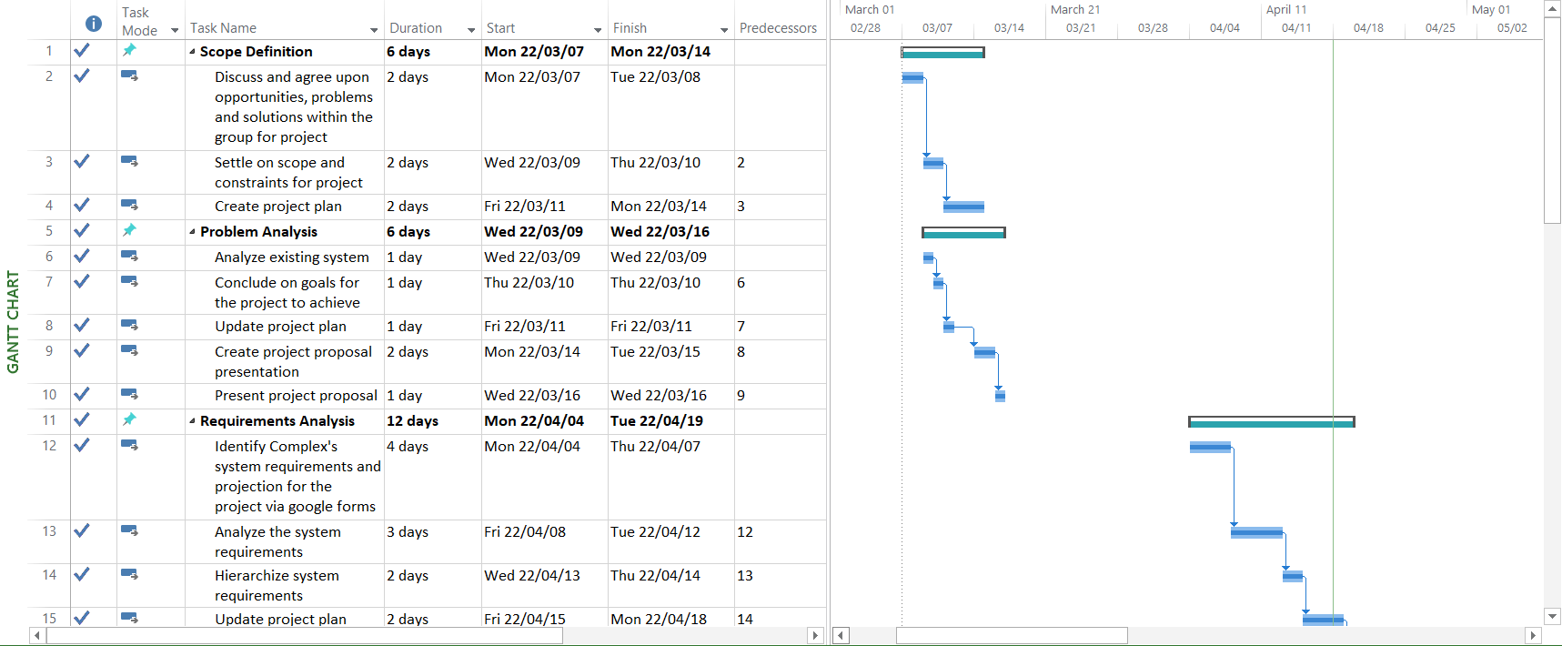
1. PROJECT plan

Slide 4
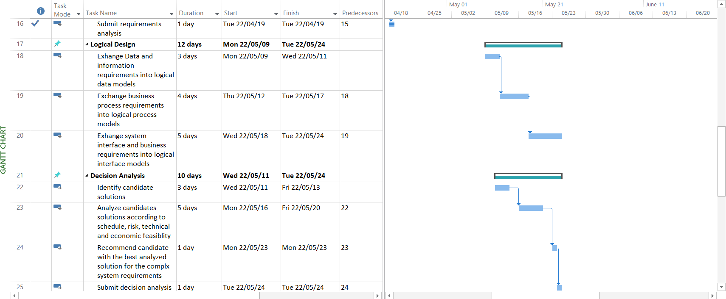
1. PROJECT plan (Cont.)

Slide 5
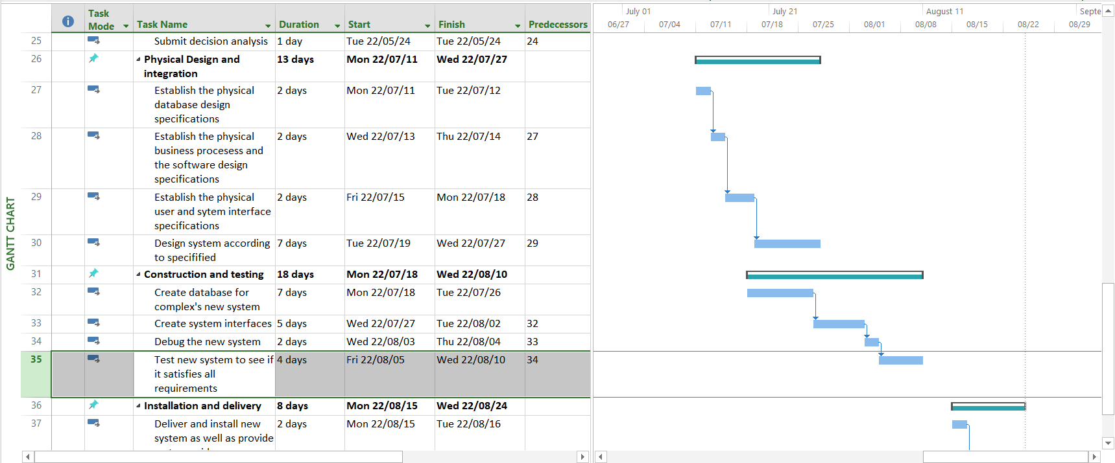
1. PROJECT plan (Cont.)

Slide 6
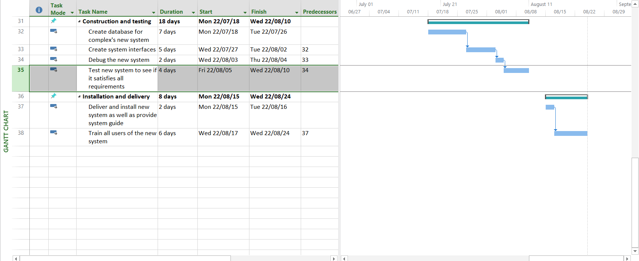
1. PROJECT plan (Cont.)

Slide 7
2. DEFINITIONS, ACRONYMS and ABBREVIATIONS
Abbreviations:
N/A – Not Applicable
RR – Reports Receivable
GUI – Graphical User Interface
GUI – Graphical User Interface
SQL - Structured query language
Definitions:
None

Slide 8
3. PROJECT DESCRIPTION AND SCOPE
Background:
The Bronze League complex, located in North-West, Potchefstroom central, is an established place of accommodation for tenants of all kinds. It holds promising features within its establishment. This complex allows for the use of social facilities, which attracts the young generation of the town generously. It also accommodates washing facilities and maintenance. Tenants often find themselves in a position of ease and comfort within the grounds of the Bronze League. And due to these facts it has been a highly sought after living space within the market!

Slide 9
3. PROJECT DESCRIPTION AND SCOPE
The system must satisfy the following functional requirements:
Maintain Apartments Condition
Maintain Complex’s Tenants information
Maintain facilities
Booking a cleaner or a maintenance worker for an apartment
Booking a slot to use facilities, including social and washing facilities
Reporting of problems with facilities
Providing extensive reports for owners/shareholders, such as apartments condition report, tenants list report, and facilities condition report

Slide 10
3. PROJECT DESCRIPTION AND SCOPE
In addition the system must satisfy the following non-functional requirements:
There must be extensive error management and Data verification
Users must create a strong password to log in every time, after 3 failed login attempts the program will block the user to protect private information. Log in will also identify the user and make the enquiries easier to trace back to the enquirer.
The interface must be clear and concise in what it presents to the user
The database will be holding up to date information about the 30 residents and 15 apartments maintenance statuses.
Fast and responsive interface

Slide 11
4. FUNCTIONAL DATA, PROCESS and INTERFACE REQUIREMENTS
 | Input | Process | Output
Tenants | Input your details and password you provided to log on | Check whether the details is valid if the tenant. If the tenant has agreed or not agreed to a contract | If there is not a contract direct the possible tenants to the registration part of the GUI. Send them to the main GUI where bookings, registration and the info page is.
Bookings | Enter whether you want to book a facility or a cleaner/maintenance worker | Check what the details of the bookings are and then direct the tenants to the correct part of the GUI. | Booking of your facility, cleaner or maintenance. Send report and proof of booking. The tenant will also be directed to the timetable to see the times

Slide 12
4. FUNCTIONAL DATA, PROCESS and INTERFACE REQUIREMENTS
Facility Bookings | Book a facility to be used and a time that you want to book the facility | Check wheatear the spot is taken or not and book it in the system/ data base | If the time and facility is taken send user with a report back to the booking section. If not, then let the tenants know the booking is complete and send a report.
Cleaner or maintenance workers bookings | Book a Cleaner or maintenance workers to be active and a time that you want to book a Cleaner or maintenance workers | Book a time for the tenants and proses the details needed for the Cleaner or maintenance workers | Booking reference sent to the tenants and the details of the Cleaner or maintenance workers as to protect their privacy.
RR | The selectin of the divert types of bookings as the input | The proses will save the details of the requested booking or application. | The report is sent to the tenant that will indicate his specified report.

Slide 13
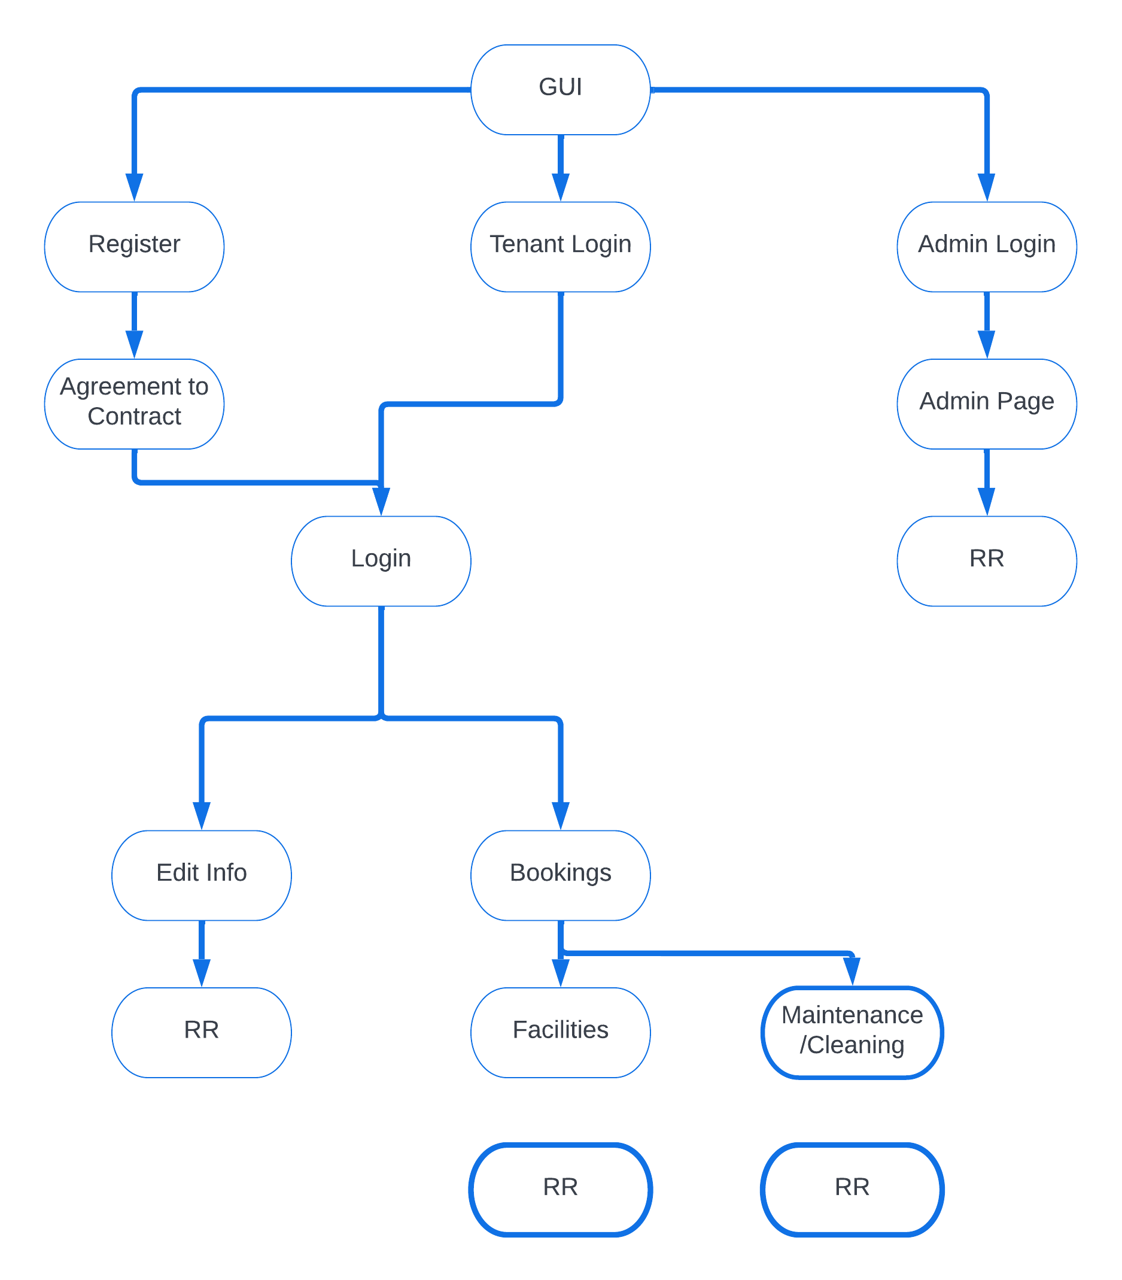
4. INTERFACE REQUIREMENTS

Slide 14
5. NON-FUNCTIONAL REQUIREMENTS
Requirements | P.I.E.C.E.S. Categories
Fast and responsive interface | Performance
Database must hold up to date records of each instance of the 30 tenants | Efficiency Control
There must be identifiers so that a query can be traced back to the enquirer if further help is to be given | Security

Slide 15
5. NON-FUNCTIONAL REQUIREMENTS
Usernames and Passwords must be unique and no shorter than 6 characters. There must be identifiers so that a query can be traced back to the enquirer if further help is to be given. And after 3 failed attempts of logging in the account that is trying to login will be banned | Security or Control
There must be extensive error management and Data verification | Control
The interface must be clear and concise in what it presents to the user | Performance

Slide 16
6. Candidates System Matrix
Characteristics | Candidate 1 AS – IS | Candidate 2 COTS Package Software Solution (Evergreen ILS) | Candidate 3 Custom Designed Solution
Brief Description | Do nothing: Continue with current business processes | Candidate will buy a PC that will be used to automate the slow, inefficient paper back databases | Candidate 2 along with additional software for easier and more efficient management.
The portion of the Bronze League Complex’s system that will be covered by the candidate. | Paperback databases, which is very inefficient. | Automated databases with a computer | All maintenance and cleaning responsibilities are taken over by external factors and no longer holds the responsibility of internal factors

Slide 17
6. Candidates System Matrix
Benefits | Cheaper costs | Better on communication between tenets and staff Less labour (No paper filing needed) | Better maintenance and cleaning efficiency Better on minimising user error Better in the case of access for tenets towards all facilities
Additional software | N/A | Operating System: Linux Office Software: PostgreSQL | Operating System: Windows 11 Home Office Software: Microsoft Office 365 Personal Visual Studio 2019 Community

Slide 18
6. Candidates System Matrix
Servers and Workstations | N/A | Entry level computer with basic database applications needed | A good computer is needed with the latest version of Windows for the optimal experience for the user and to make the database as efficient and fast as possible
Software Tools Needed | N/A | N/A | The database(s) will be constructed in Visual Studio’s SQL Server Database The candidate will use the latest version of Microsoft Windows

Slide 19
6. Candidates System Matrix
Method of Data Processing | Client must make personal contact with an employee to arrange maintenance | All data is processed in real-time on a server | All data will be processed in real time on workstation computers. If a server is used, the server’s database(s) will also be updated when needed.
Application Software | N/A | The candidate system will cover all the maintenance needs, such as: · The editing, removal, and addition of client accounts in the database. · The editing, removal, and addition of bookings in the database. | The candidate system will cover all the maintenance needs, such as: · The editing, removal, and addition of client accounts in the database. · The editing, removal, and addition of bookings in the database.

Slide 20
6. Candidates System Matrix
Output Devices and Implications | N/A | The output will be displayed in the system and will be viewable on a monitor. | The output from the system, such as reports will be displayed on a monitor. Clients will be able to view the reports including scheduled maintenance on their mobile device
Input Devices and Implications | N/A | A keyboard and mouse are required for basic GUI input. | A keyboard and mouse are required for basic GUI input.

Slide 21
6. Candidates System Matrix
Storage Devices and Implications | N/A | All the candidate’s storage requirements are met with the use of a workstation computer‘s hard drive. An entry level computer may be slow, so the candidate can also make use of Cloud storage (such as Dropbox) to store the data | The candidate’s databases can be stored on a workstation computer‘s hard drive or on Cloud storage (such as Dropbox)
Output Software | N/A | The candidate is independent of other output applications and formats. | The candidate is independent of other output applications and formats.

Slide 22
7. Feasibility System Matrix
Description | Wt. | Candidate 1 AS – IS | Candidate 2 COTS Package Software Solution (Evergreen ILS) | Candidate 3 Custom Designed Solution
Technical Feasibility | 20 | At Bronze league the only technical system they are using are paperback systems. Score: 10 | The candidate will use the system and programs provided by the developers in order to maximize their efficiently. Score: 40 | Candidate will use the designed system to run their operation more smoothly. The developers and project team will have all the knowledge to design and program the system and everything regarding that. Score: 80

Slide 23
7. Feasibility System Matrix
Operational feasibility | 10 | The system currently in use is the Paperback databases, which is very inefficient. It has the possibility of getting lost, mixed up and it uses much more space, and this can cause errors. This is also time consuming and not user friendly. Score: 20 | An automated database with a computer which can run, store and manage all the operating factors of the candidate. The candidate will be able to access the system and use it to run the operation. There will be a learning curve, but the users must trust the system. Score: 60 | The system will fulfil the users needs in all aspects and make the organization much more efficient. Maintenance and cleaning responsibilities are taken over by external factors and the developers are responsible for any changes regarding the system. This means that no longer does the candidate hold the responsibility of internal factors and the general maintenance of their “old paper back system. Score: 80

Slide 24
7. Feasibility System Matrix
Risk feasibility | 20 | The paper back system is physical and has the possibility of getting lost or damaged. Score: 10 | The system can not meet the required specifications that the company wanted, and the technologies may be unfamiliar with the user Score:20 | The project team has the necessary skills and the amount of experience to create the system and implement it into the users needs. With an experienced team the failure of the implementation is low and success will be reached easily. Score: 80

Slide 25
7. Feasibility System Matrix
Economic feasibility | 20 | N/A | Operating System: Linux Office Software: PostgreSQL • Operating System: Windows 11 Home 64bit = R2,399.00 • Office Software: Microsoft Office 365 Personal = R799.00 Total Software cost = R3 198.00 | Operating System: Windows 11 Home Office Software: Microsoft Office 365 Personal The cost to get the system up and running as well as maintenance will be as follow:

Slide 26
7. Feasibility System Matrix
Economic feasibility |  | Score: 100% | Score: 90% | • Internal cost = 20% x 2 people working 8 hours a day for 4 months @R200/h = R57 600.00 • Consultant Cost = 6 People working 4 hours a day for 4 months @R300/h = R648 000.00 Total Labour cost = R57 600 + R648 000 = R705 600 Total Costs = Labour + Hardware + Software = R705 600 + R9 900 + R3 198 = R718 698.00 Score: 60%

Slide 27
7. Feasibility System Matrix
Schedule feasibility | 10 | N/A Score: 0 | The previous team was familiar with the system, but the use of a paperback system made it more complicated and unorganized. It is also much more time consuming. Score: 10 | The team must implement all the previous data from the candidate and design a correct system. Score: 20

Slide 28
7. Feasibility System Matrix
Legal feasibility | 10 | N/A Score: 100 | N/A Score: 100 | N/A Score: 100
Weighted feasibility | 100% | 140/670 = 21% | 210/670 = 31% | 320/670 = 48%

Slide 29
8. Use-case glossary
Use Case Name | Use Case Description | Participants
Login User | The event where the user logs into the system with their username/email/phone number and password | Administrator Secretary Tenants
Register | The Event where a person can register to be added to the System/Database | Administrator Secretary Tenants
Book Facility | The event where a person can book a facility | Administrator Secretary Tenants
Cancel Booking | The event where a person can Cancel a booking of a facility | Administrator Secretary Tenants

Slide 30
8. Use-case glossary
Cancel Service | The event where a service can be cancelled | Administrator Secretary Tenants
Request maintenance | The event where someone can request maintenance | Administrator Secretary Tenants
Check Tenants | The event where every current tenant’s information can be displayed and verified | Administrator Secretary
Add User | The event where a User can be added to the system/database | Administrator Secretary
Remove user | The event where a User can be removed from the System and Database | Administrator Secretary
Backup Data | The event where all current data will be backed up to a secure storage medium | Administrator
Verify data Integrity | The event there all current data on the database will be verified | Administrator

Slide 31
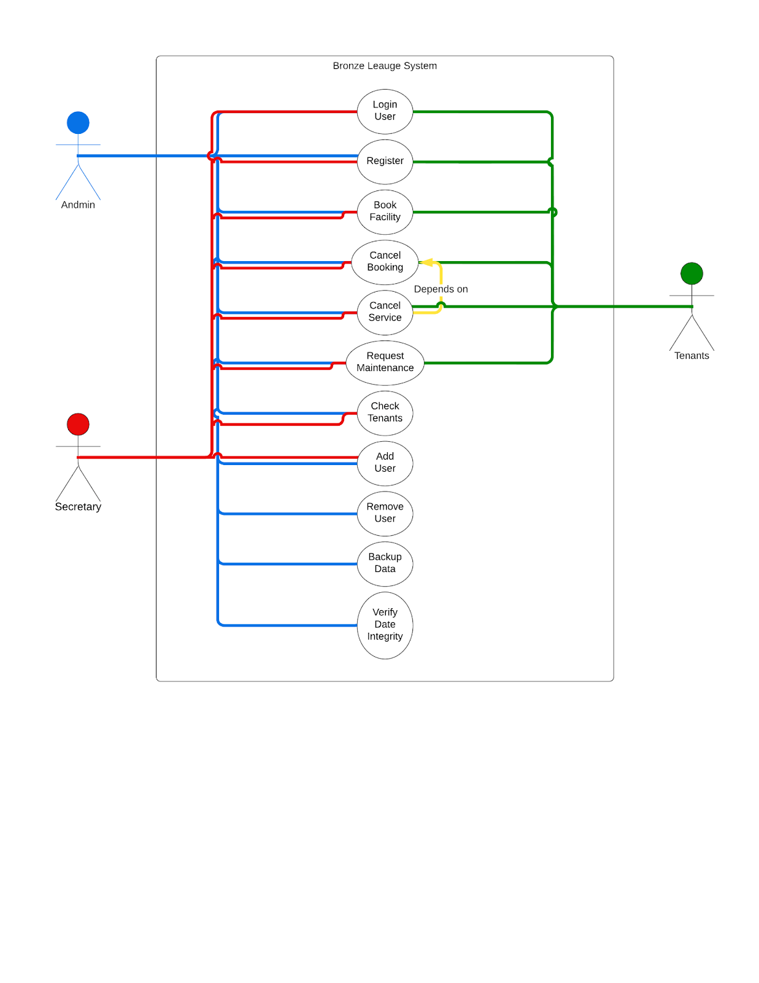
8. Use-case model diagram

Slide 32
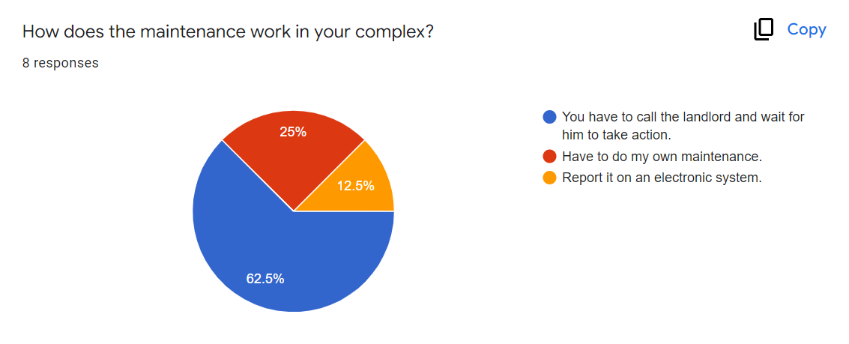
9. DATA FINDING TECHNIQUES USED
Complex forms:

Slide 33
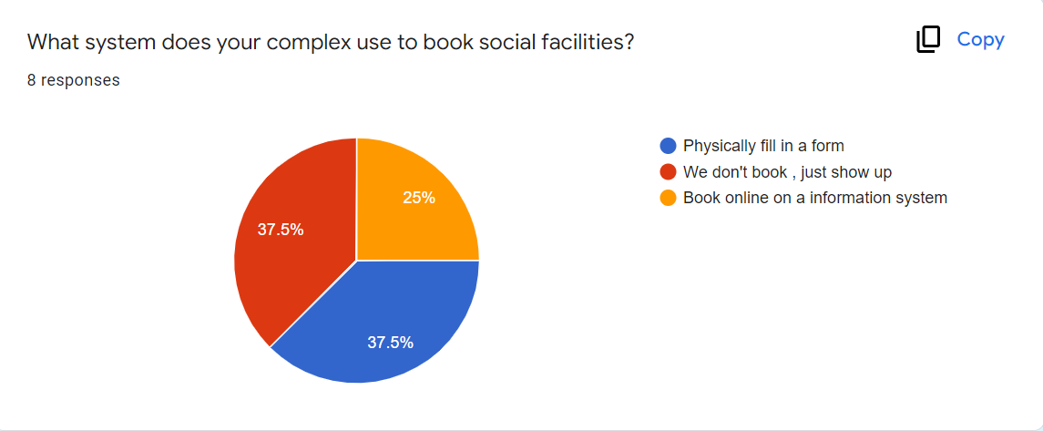
9. DATA FINDING TECHNIQUES USED

Slide 34
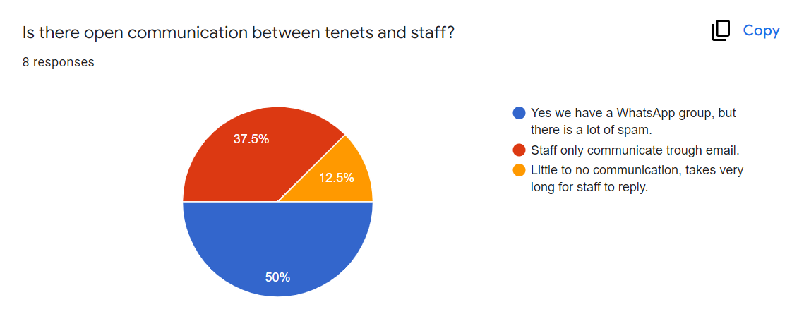
9. DATA FINDING TECHNIQUES USED

Slide 35
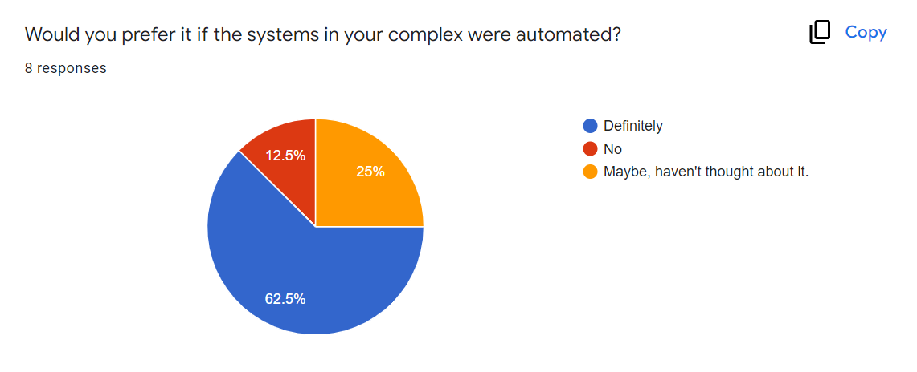
9. DATA FINDING TECHNIQUES USED

Slide 36
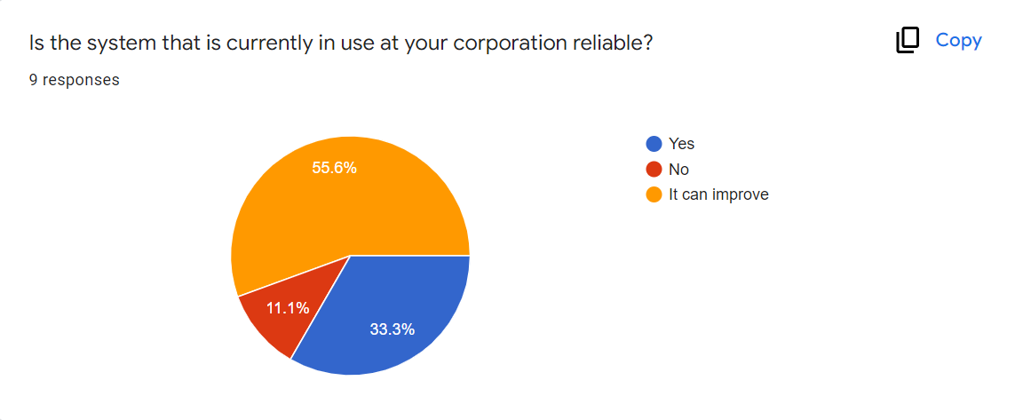
9. DATA FINDING TECHNIQUES USED
Corporate forms:

Slide 37
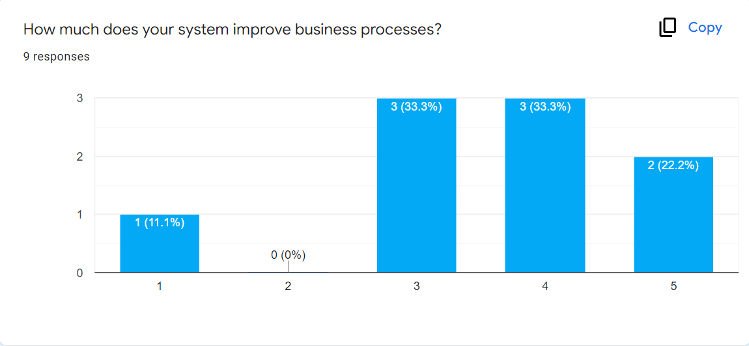
9. DATA FINDING TECHNIQUES USED

Slide 38
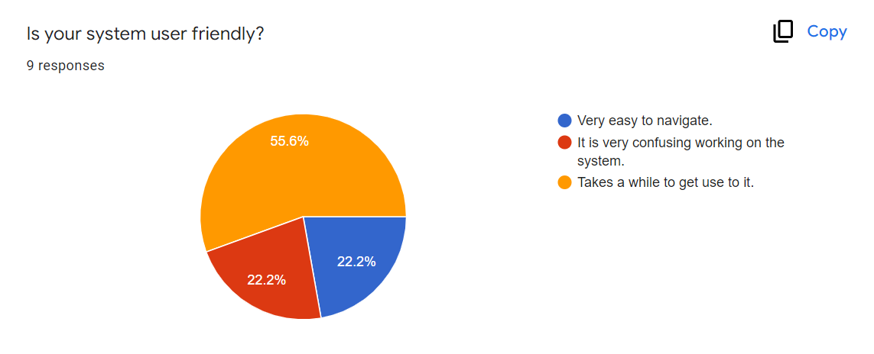
9. DATA FINDING TECHNIQUES USED

Slide 39
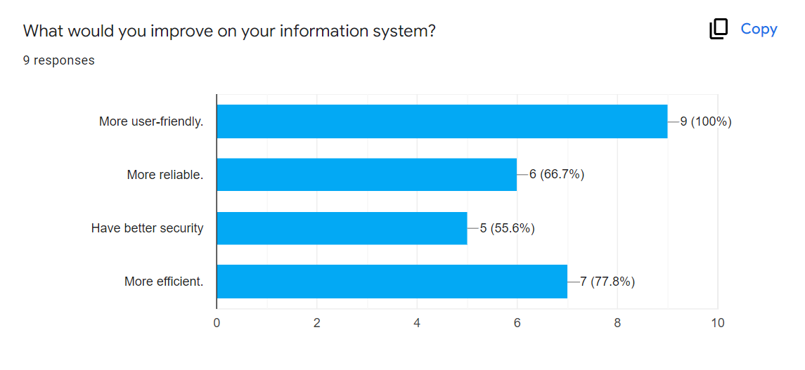
9. DATA FINDING TECHNIQUES USED

Slide 40
9. DATA FINDING TECHNIQUES USED
Interview with the complex owner:
Interviewer: Regan Williamson, System owner
Time | Question/Action | Answer
2 min | Explain to the interviewee that we are trying to do research about the systems in complex buildings to hopefully be able to automate the systems.
4min | What system is currently used to book your complex facilities and are you happy with the system? | At the moment there is no system, it is first come first serve. Some of the residents have complained before about this system and I think it is frustrating.

Slide 41
9. DATA FINDING TECHNIQUES USED
3min | How does maintenance work in the complex? | If something needs fixing, the residents must email or call me to report it and wait for me to organize someone to come attend to their problem. Sometimes it’s hard to find someone to do maintenance on short notice.
3min | If there was an automated system specially designed for complex buildings, and according to your needs as owner and your resident’s. | If the system is affordable and reliable, I would consider it because it would benefit me and my residents.

Slide 42
10. SUMMARY, FUTURE & FURTHER PLANNING
This document contains all the information system requirements for the Bronze League Complex, therefore this document concludes the Requirements Analysis phase. With this document finished, the Scope definition, Problem Analysis and the Requirements Analysis phases are completed. The project group will start with the next phase, Logical Design, on the 9th of May 2022, which will be completed by the 24th of May 2022. The Decision Analysis phase will also kick off within the provided timeframe of the Logical design on the 11th of May 2022. This phase will be completed on the same date as the Logical design, being the 24th of May 2022.

Slide 43
10. PERT CHART
6,9
A
40,43
79,82
0,0
G
F
E
53,56
71,74
H
C
B
D
6,8
18,21
30,33

